Slide 1


SMART INDIA HACKATHON 2025
TITLE PAGE
Problem statement ID - SIH25053
Problem Statement Title-Improved Onion Storage Technology for Enhancing Shelf Life of Onions
Theme-Agriculture, Food Tech and Rural Development
PS Category-Hardware
Team ID -
Team Name – Circuit Sparkers

Slide 2
Circuit sparkers
Improved Onion Storage Technology
Smart onion storage system
Generally onions damages due to
High Temperature
High Humidity
Poor Ventilation
Gas accumulation-onions naturally emits ethylene gas .it causes sprouting and ripening leads to faster spoilage.
To avoid this problems “Smart onion storage system” is used for
temperature control(>35degrees C we use control fans)(<20 degrees C we use heater coil).
High humidity (>70% we use de-humidifiers).
For Gas accumulation(we use exhaust fans ).
@SIH Idea submission-Template
2

Slide 3
HOW IT ADRRESS THE PROBLEM
Circuit sparkers
Most of the post-harvest onion losses (30–40%) happen right after harvest, before they even reach mandis or transport.
If storage is improved at the source (farmer’s field or cooperative warehouse), onions stay fresh longer → less rotting, higher income for farmers, and more stable supply in the market.
How smart onion storage systems can help farmers :
Controlled Ventilation & Temperature - Uses sensors (temperature, humidity, CO₂) to regulate air flow. Prevents overheating and maintains optimal storage temperature (~25–30°C).
Humidity Regulation - Smart fans and dehumidifiers remove excess moisture . Keeps relative humidity around 65–70%, ideal to prevent sprouting/rotting.
IoT & Real-Time Monitoring - Farmers get alerts on mobile apps/SMS about conditions inside storage .Predictive analytics warn farmers about possible spoilage.
Innovation and uniqueness of the solution
Impact on storage time :
with out smart storage (2-4 weeks)
With smart storage(3 to 6 months)
@SIH Idea submission-Template
3

Slide 4
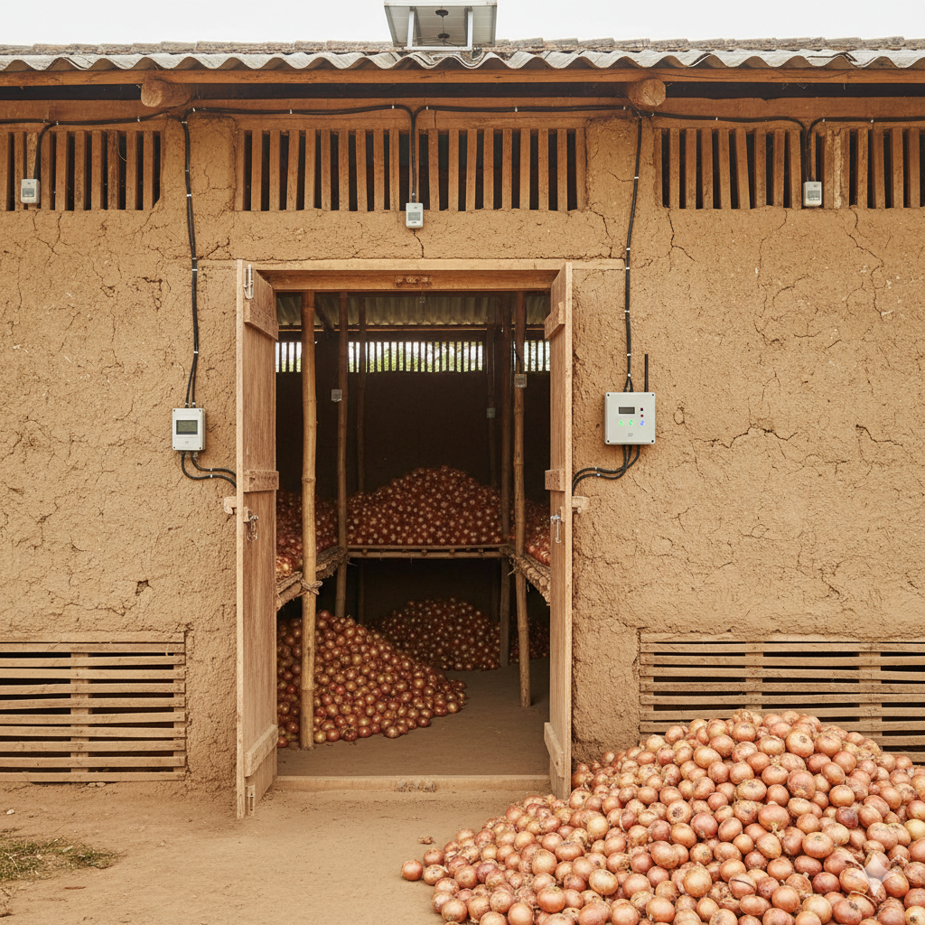
Technologies to be used : Automation technology to optimize storage conditions and IOT applications for communication and monitoring
Circuit sparkers
TECHNICAL APPROACH
Methodology and process for implementation:
Temperature sensor : DHT22
Humidity Sensor : DHT22
Gas Sensor :MQ-137 for NH3
MQ-136 for H2S
Micro controller : ESP32-WROOM-32D
ALERTS(SMS / Push notification) if:
Temperature is too high/low
Humidity is out of range
Gas concentration is high (onions spoiling)
ON/OFF control for:
Cooling fan
Humidifier / Dehumidifier
Ventilation system
@SIH Idea submission-Template
4

Slide 5
Analysis of the feasibility of the idea
Circuit sparkers
FEASIBILITY AND VIABILITY
Technically Feasible (IoT + sensors are well proven).
Economically Feasible (cost recovered from reduced wastage).
Operationally Feasible with training and awareness.
Socially Feasible with strong demand in agriculture sector.
Environmentally Feasible with positive long-term impact.
Potential challenges and risks
The main challenges are power, connectivity, cost, and durability.
The main risks are low adoption, hardware failure, and poor ROI if not properly supported.
Strategies for overcoming these challenges
Tech side: Use durable sensors, solar backup, offline logging, modular design.
Economic side: Subsidies, shared storages, ROI awareness.
Operational side: Local-language apps, easy maintenance, village technicians.
Adoption side: Demonstrations, pilot projects, farmer training.
@SIH Idea submission-Template
5

Slide 6
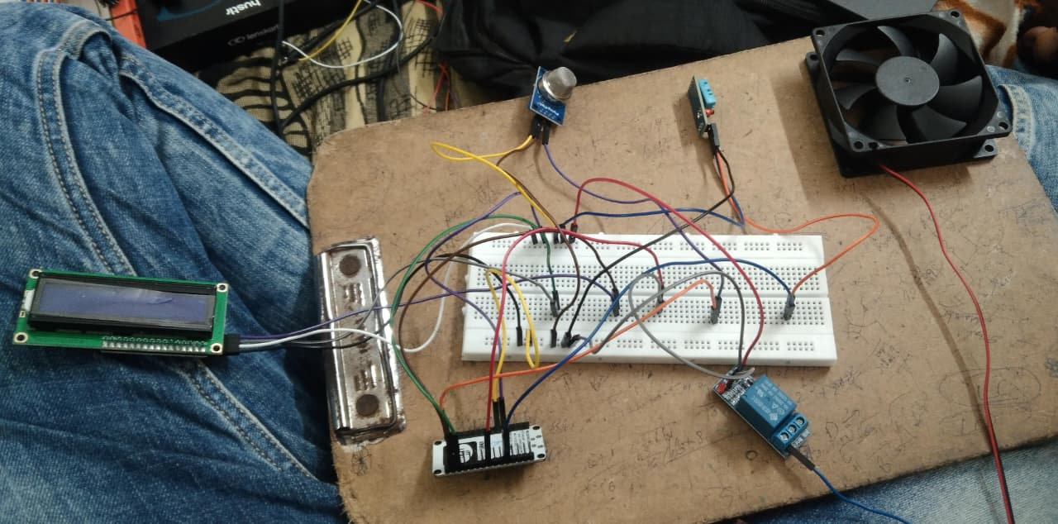
Circuit sparkers
IMPACT AND BENEFITS
Potential impact on the target audience
Farmers gain income + storage security.
FPOs get better collective bargaining.
Consumers enjoy stable prices & quality.
Government benefits from food security & price control.
Benefits of the solution:
The solution creates social upliftment (better food security, farmer empowerment), economic growth (higher incomes, price stability), environmental sustainability (reduced waste, eco-friendly power), and technological advancement (IoT in agriculture).
RESEARCH AND REFERENCES
https://www.researchgate.net/publication/294881187_Designing_and_evaluation_of_onion_storage_structures_for_Indian_conditions
@SIH Idea submission-Template
6

